Slide 1

Wine Data Analysis
IST 652
Sammy Pardes
9/1/2020

Slide 2
About the Data

Slide 3
Data Sources
Kaggle.com
https://www.kaggle.com/zynicide/wine-reviews
Semi-structured data
json file
129,971 rows
13 columns
Data.World
https://data.world/markpowell/global-wine-points
Structured data
.xlsx file
24,997 rows
10 columns

Slide 4
Columns
Kaggle.com
Country
Description
Designation
Points
Price
Province
Region_1
Region_2
Taster_name
Taster_twitter_handle
Title
Variety
Winery
Data.World
Vintage
Country
County
Designation
Points
Price
Province
Title
Variety
Winery

Slide 5
Columns
Location:
Country - Country of origin of the wine
Province - State within the country
County/Region_1 - County within the state
Winery - Winery where the wine comes from
Description - Brief summary of how the wine tastes
Points - Wine score
80-84 = Good
85-90 = Very good
90-94 = Outstanding
95-100 = Classic, great
Price - Cost per bottle in USD
Title - Name of the bottle of wine
Variety - Type of grapes used in the wine

Slide 6

Data Cleaning

Slide 7
Data Cleaning
“Taster_name”, “taster_twitter_handle”, “region_2”, “designation” and “vintage” fields removed
“$” and “,” characters replaced with “” for “price”
“Price” converted to float data type
“Points” converted to integer data type
“Region_1” renamed to “county”
Column names set to lowercase
Rows with NAs removed
Data World: 19,494 rows Kaggle: 101,400 rows

Slide 8
Combining Data Sets
Created dataframe from “title” and “point” fields from data without descriptions
Joined new data frame where “title” fields match
“avgPoints” field created with mean()
NAs dropped
Individual point scores dropped
17,298 wines in both data sets

Slide 9
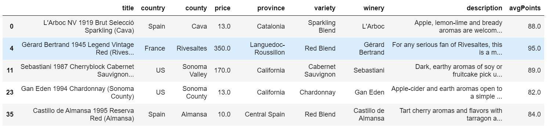
Cleansed Data Frame

Slide 10
Data Analysis/Question: Can one determine the quality (score) of a wine from information found on the wine label?

Slide 11
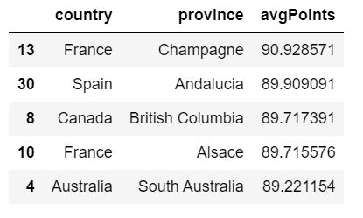
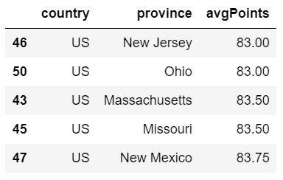
Data Analysis: Provinces
Groupby() and mean() functions
Wines sorted by the average number of points scored for all wines in each country/province combination
Matplotlib and seaborn used to create a barplot
Y-axis set to 80-95 points

Slide 12
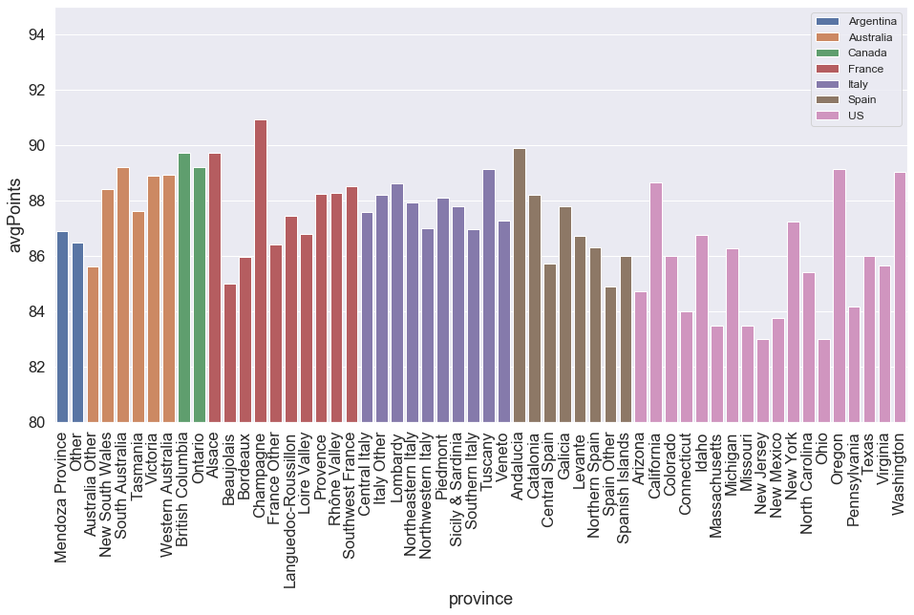
Average wine score grouped by country and province

Slide 13
Data Analysis: Counties
nlargest() to get the 10 highest scoring provinces
4,345 wines stored in new data frame
Groupby() used to sort the wines in the best provinces by the average county score
Y-axis set to 90-95 points

Slide 14
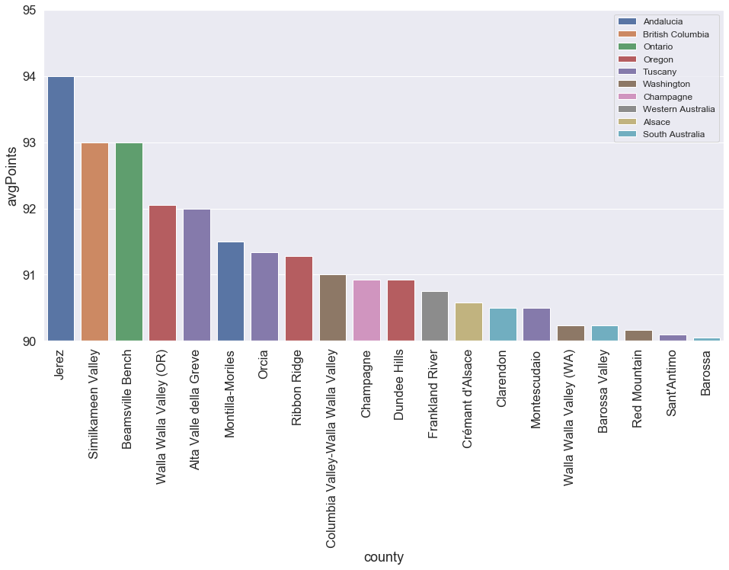
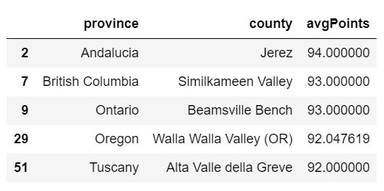
Average wine score grouped by province and county

Slide 15
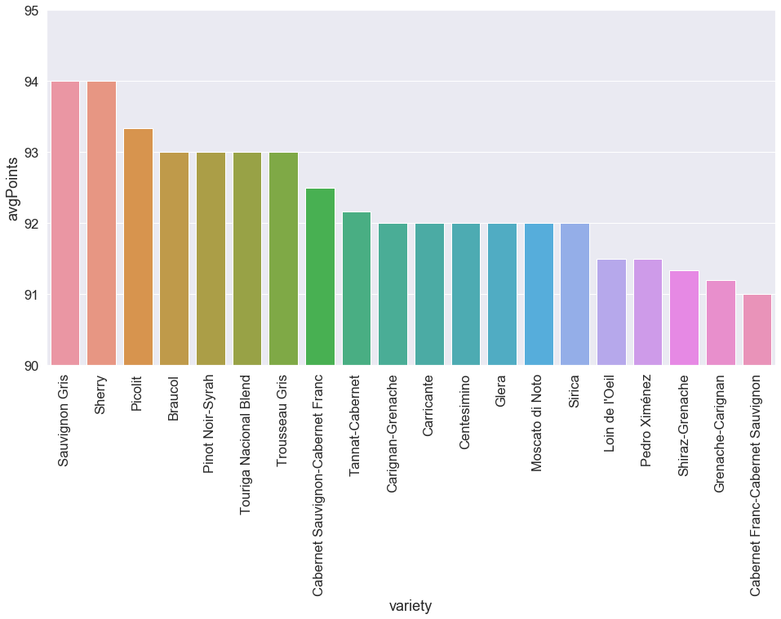
Data Analysis: Varieties
304 unique varieties of wine
The top 20 gathered and plotted using groupby() and nlargest()
Y-axis set to 90-95 points

Slide 16
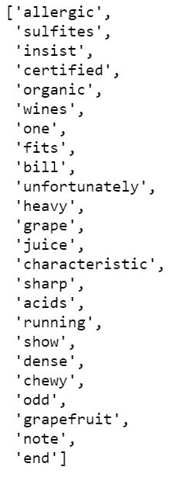
Data Analysis: Descriptions
Nlargest()/nsmallest() used to get the 1,000 highest/lowest scoring wines
Two lists created with words from the best/worst “description” fields
“Descriptions” set to lowercase
“Descriptions” tokenized with RegexpTokenizer()
English stopwords removed using nltk
Additional high-frequency words removed (“wine”, “tannins”, “flavor”)
Most_common() to plot high frequency words

Slide 17
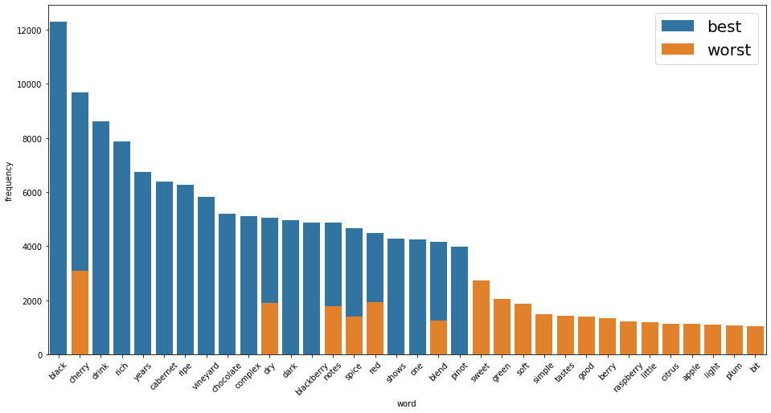
Most frequent best/worst description words

Slide 18
Data Analysis: Description Sentiment
SentimentIntensityAnalyzer() applied to the best/worst description lists
Polarity_scores used to gather average sentiment
1,000 worst reviews:
4.2085% negative
86.4729% neutral
9.3201% positive
Compound sentiment: 0.19
1,000 best reviews:
1.2325% negative
83.019% neutral
15.7493% positive
Compound sentiment: 0.72

Slide 19
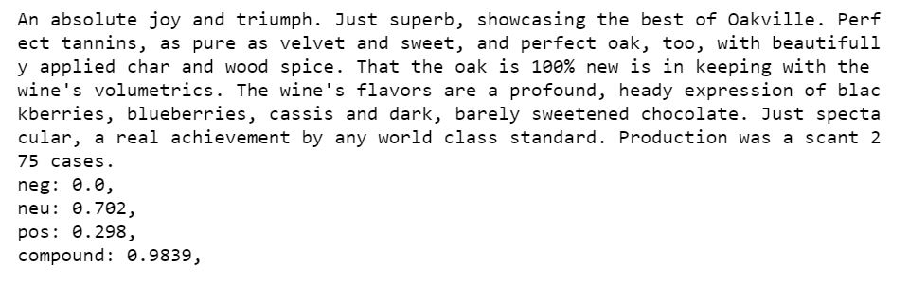
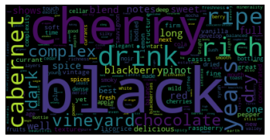
Positive description sentiment example. Best reviews word cloud.

Slide 20
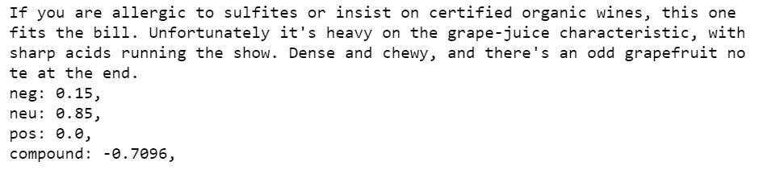
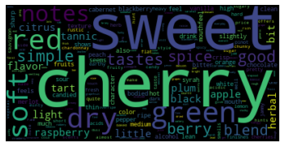
Negative description sentiment example. Worst reviews word cloud.

Slide 21
Conclusion

Slide 22
Takeaways
Country/Province
Champagne, Andalucia, and British Columbia are high-scoring provinces
Hit or miss depending on where you are in the US
Avoid New Jersey and Ohio
Stick to California, Oregon, Washington
County
Wines in Jerez, Similkameen Valley, and Beamsville Bench counties score highly
Variety
Sauvignon Gris, Sherry, Picolit are the top three varieties on average
Description
Good words:
“black”, “complex”, “dark”, “years”, “rich”, “chocolate”, “blackberry”
Bad words:
“green”, “simple”, “light”, “good”, “sweet”, “raspberry”

Slide 23
Notes
All wines in both data sets scored at least 80 points
Next time, get a wider range of scores
Could use fewer wines in sentiment analysis to get more extreme results
Could use predictive analytics to predict score
Did not analyze “price” or “winery”
Remember, everyone has their own preference!

Slide 24
Questions?

